Slide 1
Quantum safe federated learning framework for cyber threat detection in 5G-enabled IOT ecosystems

Slide 2
Introduction
5G-enabled IoT ecosystems generate massive amounts of sensitive network traffic data and are increasingly vulnerable to sophisticated cyber threats such as: ICMP flood attacks, SYN flood attacks, Port scanning, UDP flood attack, etc.
Traditional centralized deep learning approaches can achieve high accuracy, but they suffer from several problems:
lack of privacy preservation
scalability issues
centralized data sharing risks
vulnerability to parameter leakage
To address these limitations, the paper proposes a quantum-safe federated learning framework called DeepFL-CTI.

Slide 3
Problem Statement addressed
Cyber Threats targeting 5G IOT ecosystems (ICMP flood, SYN flood, port scans, etc)
Cyber Threats targeting FL (model parameter leakage, insecure parameter sharing, privacy leakage during aggregation, etc)

Slide 4
Key Contributions of the Paper
Hybrid MobileNet-V1 + BiGRU Model: The paper proposes a hybrid deep learning architecture combining MobileNet-V1 and Bidirectional GRU (BiGRU) for efficient cyber-threat detection in 5G IoT environments.
Federated Learning Framework: The framework enables: collaborative learning, decentralized training and privacy-preserving model updates without sharing raw client data.
Post-Quantum Secure Aggregation: The framework integrates: lattice-based cryptography Learning With Errors (LWE) to provide quantum-safe secure communication between clients and server.
Evaluation on 5G-NIDD Dataset: The proposed framework is evaluated using multiple metrics: accuracy, precision, recall, F1-score, TPR, FPR, FNR, NPV and outperforms previous related works.

Slide 5
System Model
Trusted Authority (TA): Responsible for -
generating cryptographic keys
establishing secure communication
IoT Clients: Responsible for -
local training on private IoT data
encrypting model updates
Cloud Server: Responsible for -
aggregating encrypted model updates
updating the global model

Slide 6
Workflow
Step 1: Dataset Preparation: The 5G-NIDD dataset is: cleaned, preprocessed, normalized encoded, etc. Then divided across multiple IoT clients. Each client receives its own local private dataset.
Step 2: Key Generation (Trusted Authority): The Trusted Authority generates public key and private key using the LWE Cryptographic Scheme.
b = As + e
Where:
A → random matrix
s → secret/private vector
e → small error vector
b → public component

Slide 7
Workflow
Step 3: Distribution of Initial Global Model: The cloud server initializes MobileNet-V1 + BiGRU global model. The server sends initial model weights and public encryption key to all IoT clients.
Step 4: Secure Aggregation at Server:
Each IoT client:
receives global model weights
trains locally on its private data
updates model parameters
Using MobileNet + BIGRU model

Slide 8
Workflow
Step 5: Encryption of Local Model Updates : After local training each client encrypts updated model weights using LWE Encryption. This ensures privacy preservation and quantum-safe communication. So client never sends raw data only encrypted data to the server.
Step 6: Secure Aggregation at Server:
The cloud server performs: Federated Averaging (FedAvg) on encrypted model parameters.The server:
aggregates updates from all clients
creates updated global model weights
WITHOUT accessing any raw data.

Slide 9
Workflow
Step 7: Decryption of Aggregated Model: Using the private key generated by Trusted Authority, the aggregated global model is decrypted to obtain updated global parameters.
Step 8: Global Model Update: The server updates Global DeepFL-CTI Model with newly aggregated parameters.
Step 9: Redistribution to Clients: Updated global weights are again sent to all clients. The FL cycle repeats for multiple communication rounds until convergence is achieved.

Slide 10
Final Evaluation
After convergence the final global model performs Cyber-Threat Detection on 5G IoT network traffic
Detecting:
ICMP flood
UDP flood
SYN scan
DDoS
port scan
other attacks

Slide 11
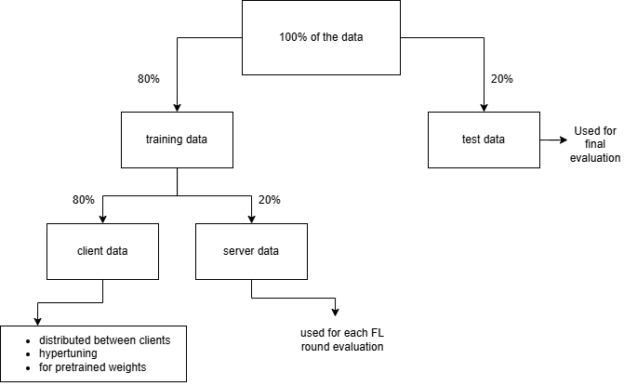
My approach 1

Slide 12
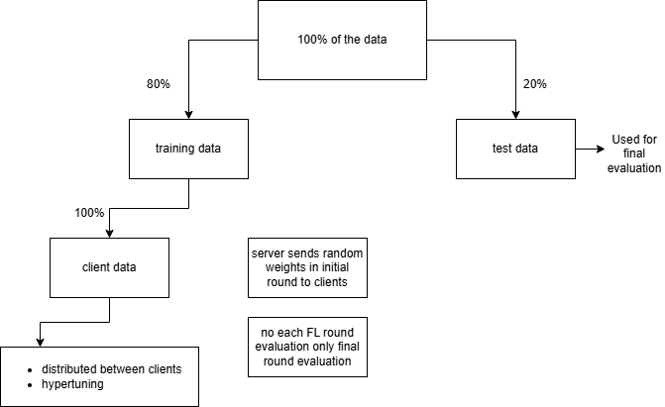
My approach 2

Slide 13
Results & Discussion
The best results came from approach 1 after implementing DeepFL-CTI model for 13 rounds for k = 5.
Accuracy = 97.77%
F1 Score = 0.9772
Macro Avg = 0.90
Precision = 0.9777

Slide 14
Approach 1 Results Comparison
K value | AC(a) | PC(a) | F1(a) | AC(b) | PC(b) | F1(b)
3 | 99.80% | 0.9962 | 0.9968 | 95.44% | 0.9557 | 0.9544
5 | 99.82% | 0.9953 | 0.9957 | 97.77% | 0.9777 | 0.9772
7 | 99.73% | 0.9959 | 0.9956 | 95.34% | 0.9561 | 0.9537
9 | 99.75% | 0.9965 | 0.9946 | 95.55% | 0.9572 | 0.9555
a = Paper results, b = My approach 1 results
AC = Accuracy, PC = Precision, F1 = F1 Score

Slide 15
Approach 2 Results Comparison
K value | AC(a) | PC(a) | F1(a) | AC(b) | PC(b) | F1(b)
3 | 99.80% | 0.9962 | 0.9968 | 97.26% | 0.9737 | 0.9729
5 | 99.82% | 0.9953 | 0.9957 | 94.43% | 0.9451 | 0.9445
7 | 99.73% | 0.9959 | 0.9956 | 93.78% | 0.9419 | 0.9382
9 | 99.75% | 0.9965 | 0.9946 | 92.88% | 0.9322 | 0.9291
a = Paper results, b = My approach 2 results
AC = Accuracy, PC = Precision, F1 = F1 Score

Slide 16
Reasons for 2-4% difference of results
Client Data Distribution Differences: Federated Learning is very sensitive to Non-IID client partitioning. Small changes in attack distribution, class balance and client heterogeneity can easily change accuracy by small %.
Encryption Overhead: Integrating: LWE encryption and secure aggregation can slightly affect:
convergence
numerical precision
aggregation stability
Especially if quantization/scaling is used.

Slide 17
Reasons for 2-4% difference of results
Fewer Extensive search and ideal scenario: Paper likely works in optimized convergence, stronger local training and ideal setup. Paper likely used extensive tuning, many experiments, manually optimized setup.
Statistical Variance in FL: Federated Learning is inherently:
stochastic
unstable
client-sensitive
Random Client Selection: ‘random.sample()’ This changes: participating clients, local gradients and aggregation path.

Slide 18
Limitations and Future Scope
Limited Real-Time Deployment Validation:
The framework is tested mainly on benchmark datasets and simulated FL settings
But not on:
actual live 5G IoT infrastructure
production-grade deployments
So real-world latency and scalability remain uncertain.
Integration with Blockchain: Blockchain can be integrated for -
decentralized trust
tamper-proof aggregation
secure client authentication
This is a very strong future scope point.

Slide 19
Limitations and Future Scope
Transformer-Based Federated Models:
Future work may explore: Transformers, Vision Transformers, Graph Neural Networks, Attention-based IDS, etc for better feature learning.
Explainable AI (XAI) Integration: Cybersecurity systems require interpretability.
Future systems can integrate:
SHAP
LIME
attention visualization
to explain attack predictions.

Slide 20
Limitations and Future Scope
Limited Analysis of Extreme Non-IID Scenarios:
Real-world IoT systems may contain:
highly skewed attack classes
clients with very little data
completely different traffic patterns
which may reduce convergence.
No Robust Defense Against Malicious Clients:
Paper does not deeply address:
poisoning attacks
Byzantine attacks
malicious model updates

Slide 21
Limitations and Future Scope
Dataset Dependency:
The model is evaluated mainly on 5G-NIDD dataset
Performance on: other IoT datasets, unseen attacks, zero-day attacks
is not extensively validated.
Lightweight Encryption Schemes: LWE is secure but computationally expensive.
Future work may explore:
optimized lattice cryptography
lightweight post-quantum schemes
hybrid encryption
for better efficiency.

Slide 22
THANK YOU

